Slide 1


Brunswick Hills Township Board of Trustees Meeting
May 12, 2026
The information contained herein is privileged and confidential to Green Thumb Industries and the intended recipient and protected from disclosure. Any unauthorized use, distribution, modification, copying, forwarding or disclosure by any person is strictly prohibited.
Confidential & Proprietary. For presentation purposes use only. 1

Slide 2


Green Thumb and RISE Dispensaries Introduction
  Overview
  Community Engagement and Partnerships
Brunswick Hills Landscape
  Medina County Dispensary Map
Proposed Dispensary Location
Public Sentiment of RISE – Google Reviews
Compliance and Security
Medical Program Benefits
Appendix
  Issue 2 Voting Results
  Known Concerns from Constituents
Agenda
Confidential & Proprietary. For presentation purposes use only. 2

Slide 3




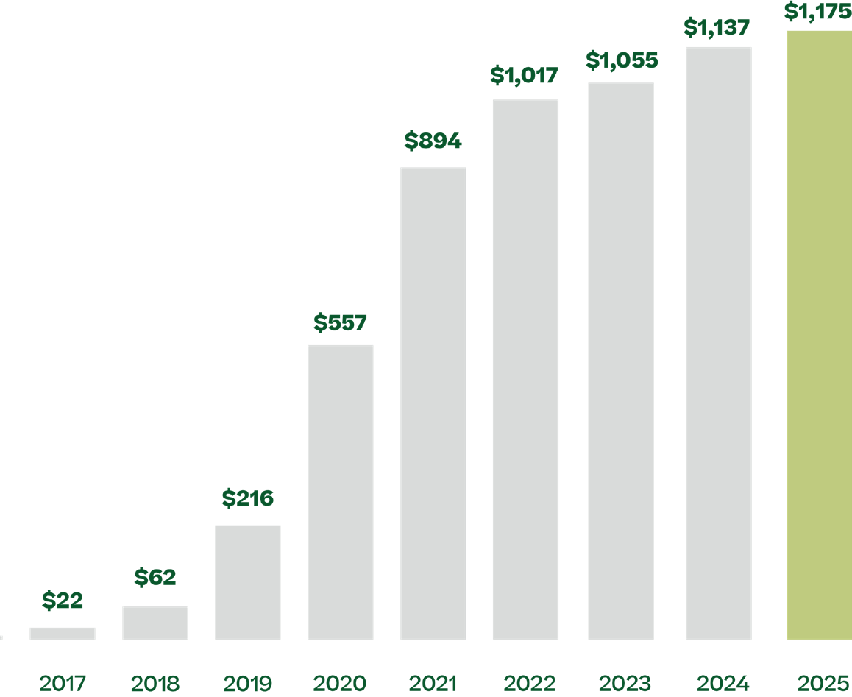
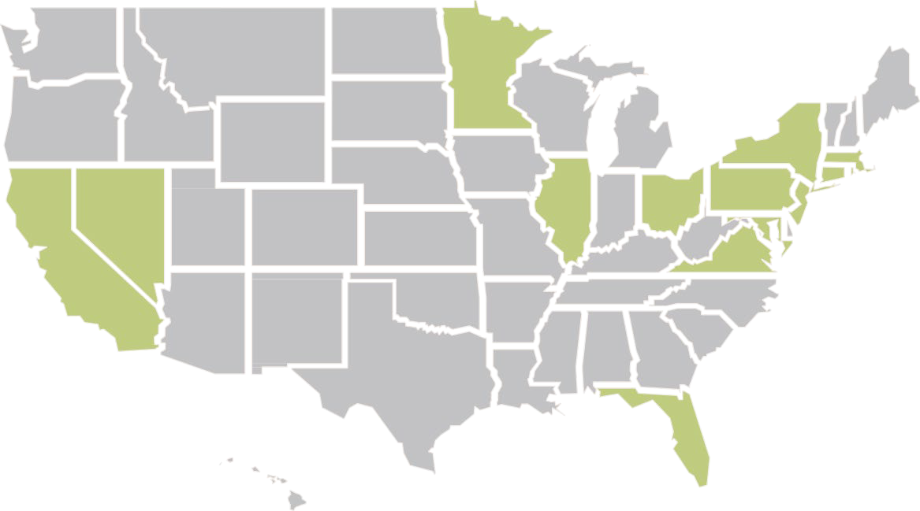

AT A GLANCE
A PLACE WHERE PEOPLE COME FIRST
Our real power is in our people and our shared commitment to giving back to the communities that we serve.
A FAMILY OF BRANDS*
Well-being is personal, which is why we
are committed to building industry-leading brands that fit different preferences and lifestyles.
DELIVERING SIGNIFICANT REVENUE GROWTH
GREEN THUMB ANNUAL NET REVENUE
( MILLIONS)
$1,017
$894
$557
$216
$62
$7 $22
2016 2017 2018 2019 2020 2021 2022
* See Slide 2, “RYTHM, Inc. Brands” for more information on our relationships with our brands.
A NATIONAL CANNABIS RETAILER
110+
OPEN RETAIL STORES
(AS OF 5 /1/26)
14 20
STAT E MANUFACTURING OPERATIONS FACILITIES
11

Slide 4

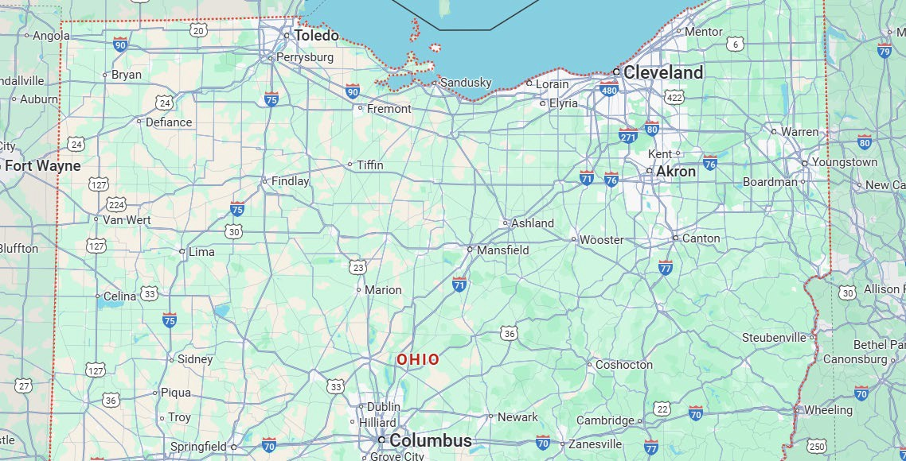


AT A GLANCE
AT A GLA NCE
GTI - Ohio
GTI - Ohio
A PLACE WHERE PEOPLE COME FIRST
Our real power is in our people and our shared
commitment to giving back to the communities that we serve.
GTI - Ohio currently employs 252 people
15-20 new employees for RISE Brunswick Hills
Personal Care Specialist start at $16/hr. + Tips.
Leaders in Training start at $19/hr. + Tips
GTI OHIO- PROUD COMMUNITY MEMBER
Since 2019, GTI Ohio has been an active member of the business communities in each city we call home. Some of the organizations we have partnered with include:
GTI - OHIO BY THE NUMBERS
112
RETAIL
EMPLOYEES
140
CULTIVATION EMPLOYEES
6
DISPENSARIES
Lorain County Urban League – Funds used to enhance the quality of life within historically marginalized communities in Lorain.
All Faiths Pantry – First Day profits from RISE Cleveland Pearl donated to program that delivers nutritious groceries to seniors and people with limited mobility
Holiday Food Drive – Shelf-stable food items collected at RISE Toledo in December 2025 for Toledo Northwestern Ohio Food Bank
Round Up 2025 - $99,895 raised in Ohio in 2025 as a result of rounding up register transactions to support various causes
AN ESTABLISHED CANNABIS OPERATOR SERVING OHIO
1
CULTIVATION &
MANUFACTURING FACILITY
R
R
R R ^{R}
RISE Cleveland Pearl
RISE Cleveland Prospect
RISE Lakewood Madison
RISE Lorain
RISE Toledo
RISE Whitehall
448,301
REGISTERED MEDICAL
PATIENTS BEING SERVED IN
OHIO * as of 12/31/24
R
4

Slide 5
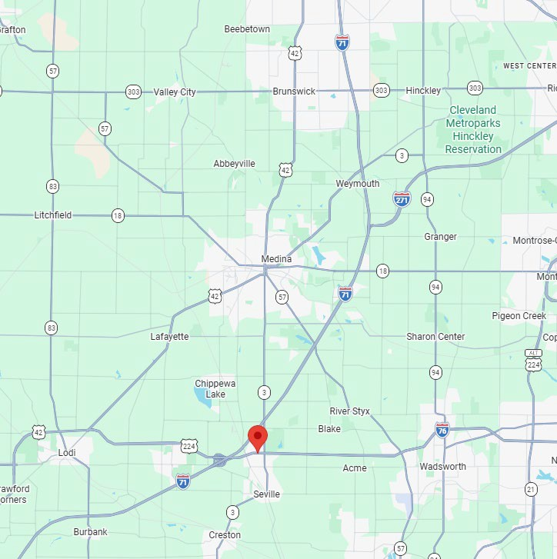

Medina County Area Dispensary Landscape
Proposed Dispensary Location
Existing Operating Dispensary
Confidential & Proprietary. For presentation purposes use only.

Slide 6
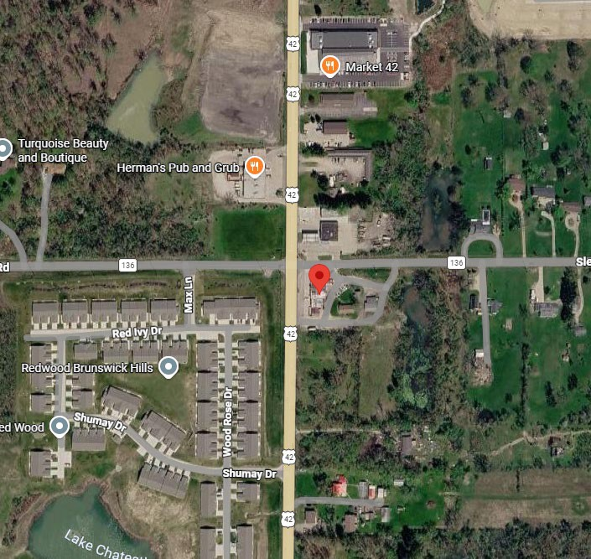
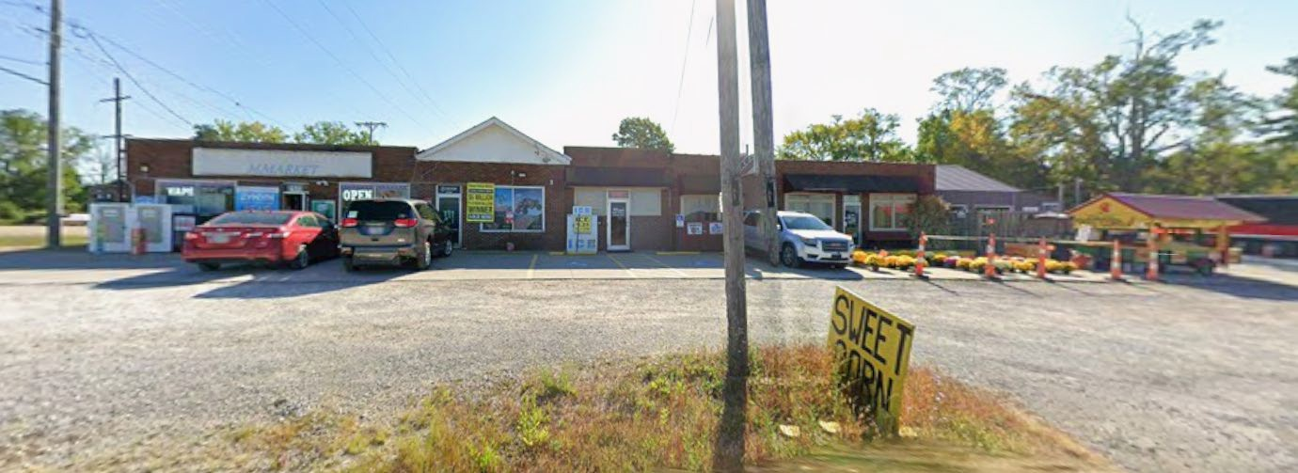
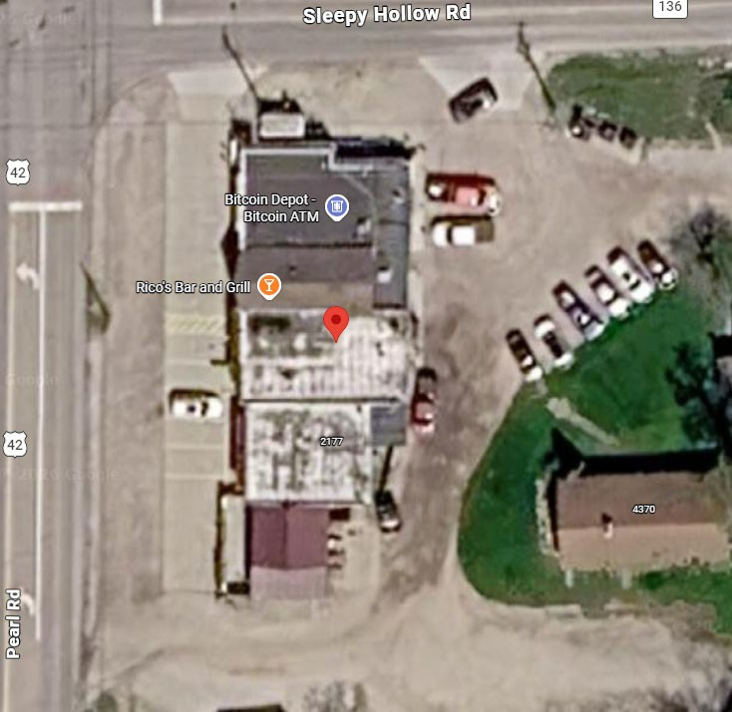
Proposed Dispensary Location – 2175 Pearl Road
Premises Square Feet – 5,200 SF
Parking – TBD – planning parking redevelopment, targeting 30+ spaces when complete
Operating Hours – 8 AM – 9 PM Monday – Saturday. Sunday 8 AM – 8 PM.
Confidential & Proprietary. For presentation purposes use only.

Slide 7
Proposed Dispensary Location – 2175 Pearl Road
WHY 2175 PEARL ROAD IS BENEFICIAL FOR RISE & THE TOWNSHIP:
Strategic, Underserved Location — Situated at the intersection of Sleepy Hollow and Pearl Road, this site fills a genuine gap in access for residents of Brunswick Hills, Medina, and Brunswick, none of whom currently have a nearby licensed dispensary. Capturing this demand locally keeps tax revenue within the Township.
Protects Township Tax Base — The site sits at the Brunswick city border. Since Brunswick has shown no interest in permitting a dispensary within its limits, this location serves as a natural buffer — reducing any incentive for future annexation and ensuring the Township retains long-term tax revenue.
Catalyzes Economic Growth in a Developing Corridor — Located near proposed and existing residential and commercial development, RISE's investment will contribute to the momentum already building in this part of town rather than standing alone as an isolated use.
Significant Capital Investment & Local Job Creation — GTI will make a substantial investment in renovating the building and improving the site, while also creating permanent local jobs. This is a long-term commitment to the Township, not a short-term play.
Large Parcel Supports Safe, Orderly Operations — GTI will control the entire premises, allowing us to maintain a secure, clean, and well-managed site with ample parking and smooth traffic flow — minimizing any impact on neighboring properties.
Full Regulatory Compliance — The site meets all Ohio state setback requirements.
Confidential & Proprietary. For presentation purposes use only.

Slide 8




Benefits to Brunswick Hills Township
JOB CREATION
IMPROVEMENT AND APPEARANCE OF COMMERCIAL PROPERTY
15 – 20 jobs created.
Full suite of benefits: Medical, Dental, Vision, PTO, 401K, Mental Health Programs, FSA/HSA, and much more…
Improving a building that has been occupied by a convenience store and bar historically.
Estimated $1.5M capital investment between interior, exterior and site work.
INCREASED ANCILLARY ECONOMIC ACTIVTY
TAX BENEFIT
Income tax, increased property tax, sales tax.
Current law provides 36% of recreational sales excise tax to be returned to the City from the Host Community Fund.
Destination element providing trickle down impact to local businesses, retailers, and restaurants.
Keeps Brunswick Township residents spending money in the Township rather than spending their money outside the community, while also drawing new activity from Medina County as a whole
Confidential & Proprietary. For presentation purposes use only.

Slide 9
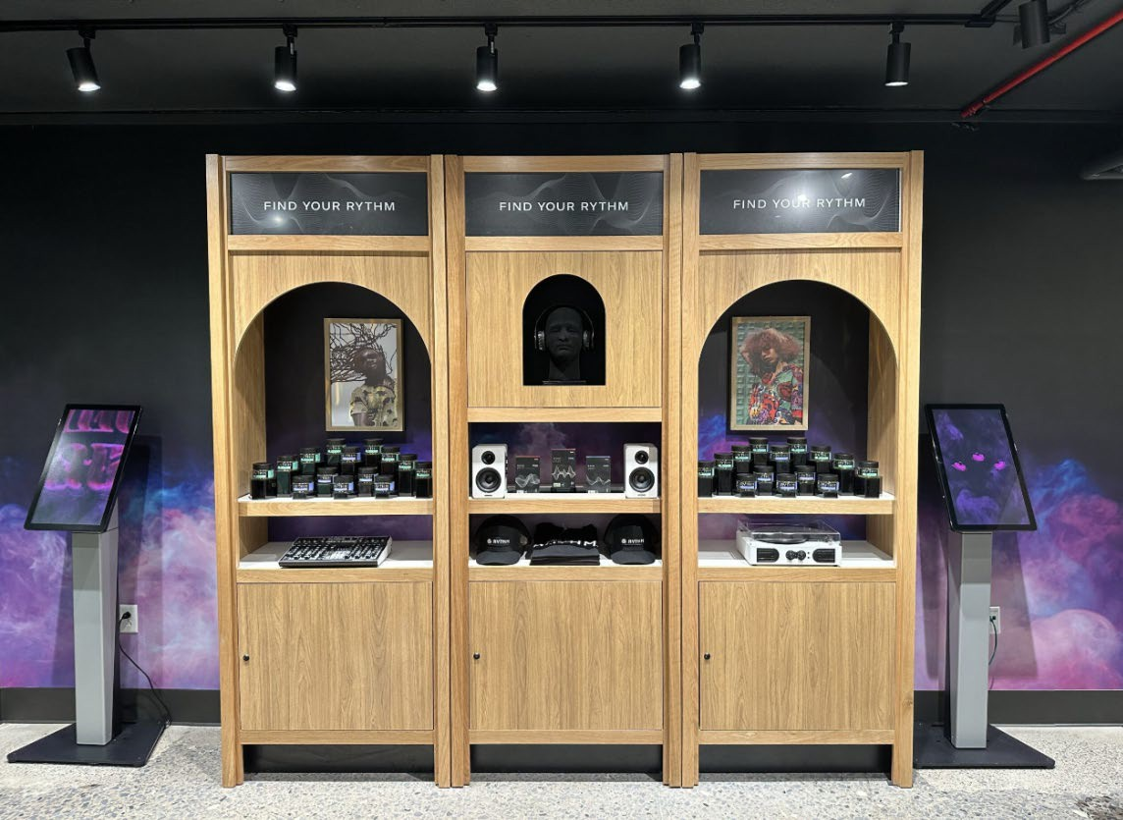
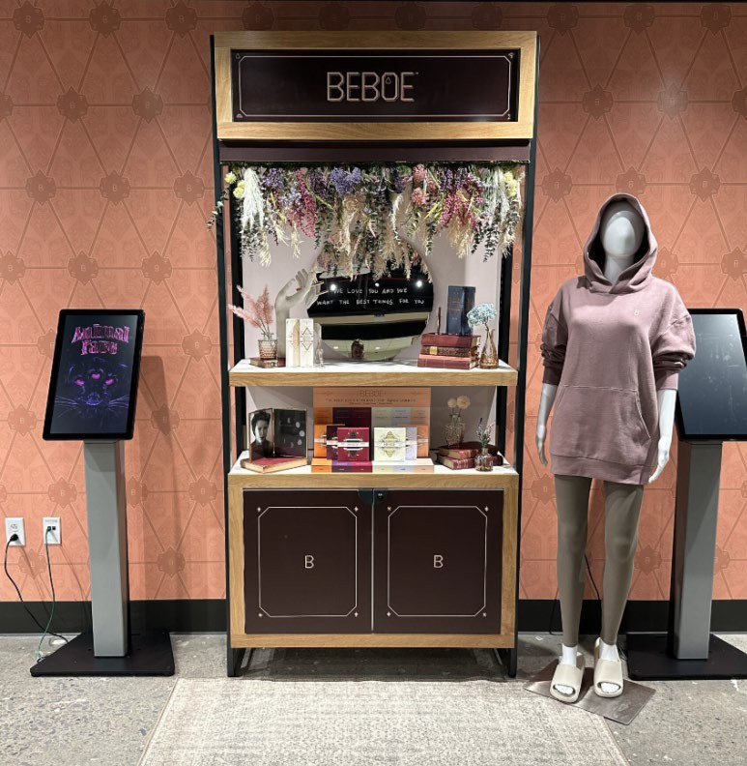
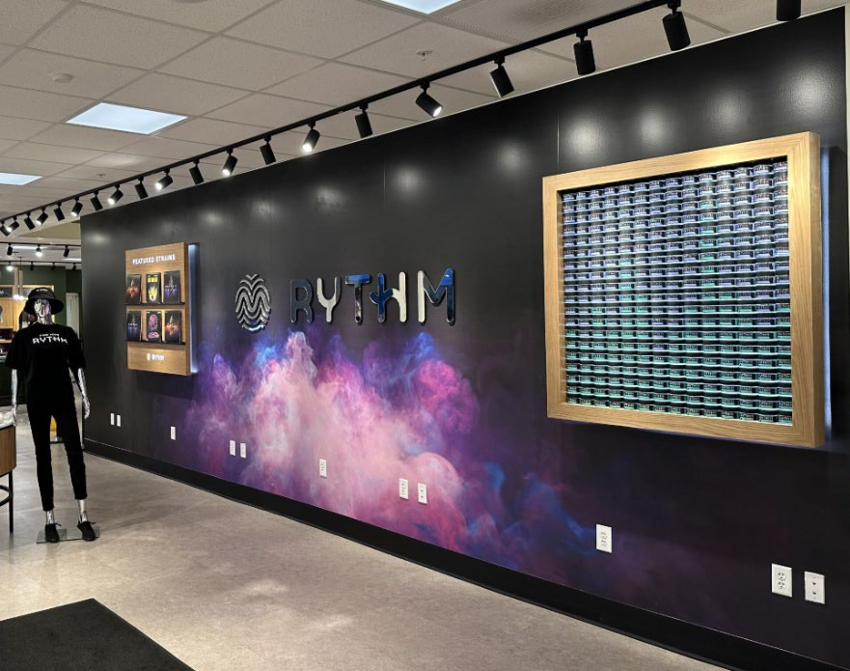
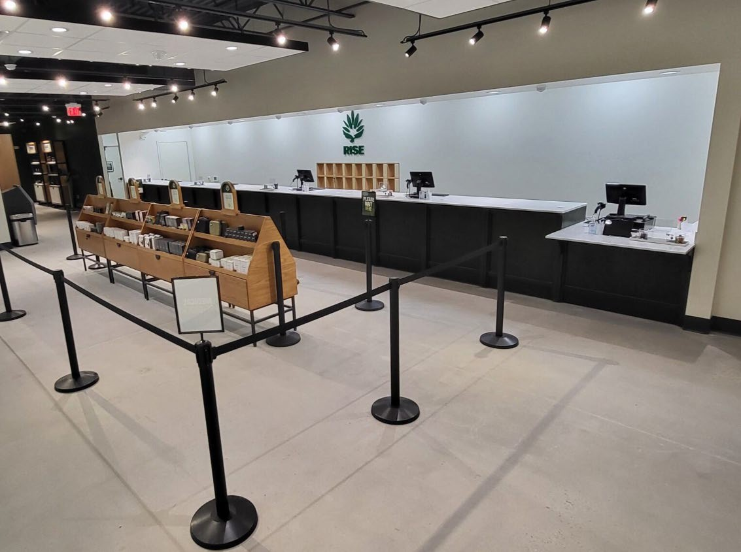
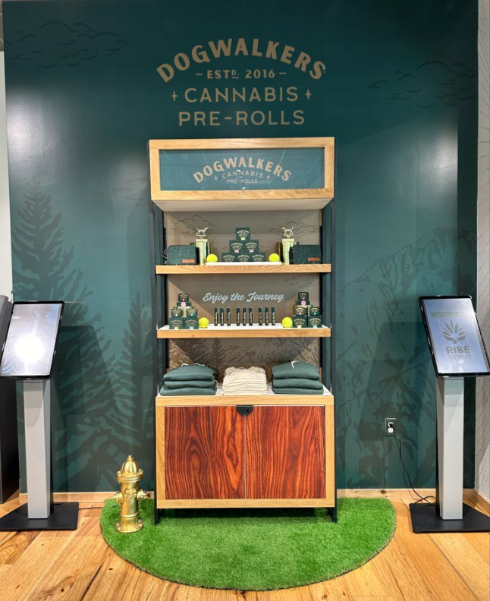
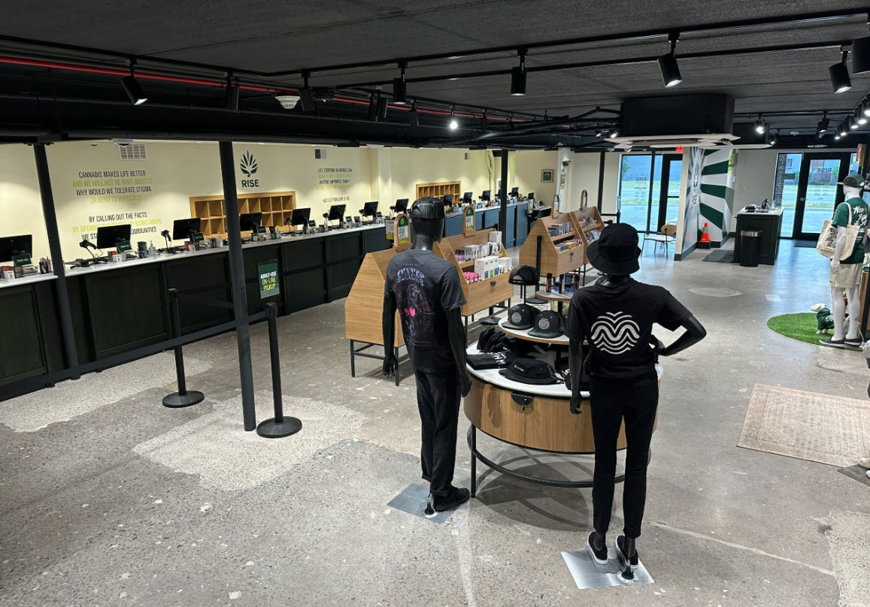
RISE – Best In Class Retail Experience
Confidential & Proprietary. For presentation purposes use only.
9

Slide 10
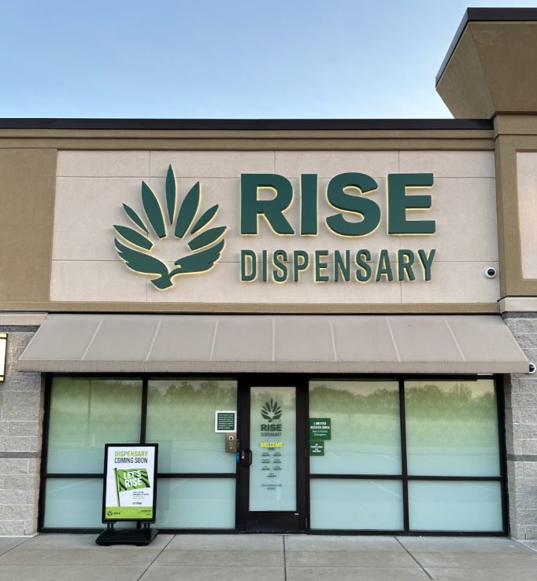
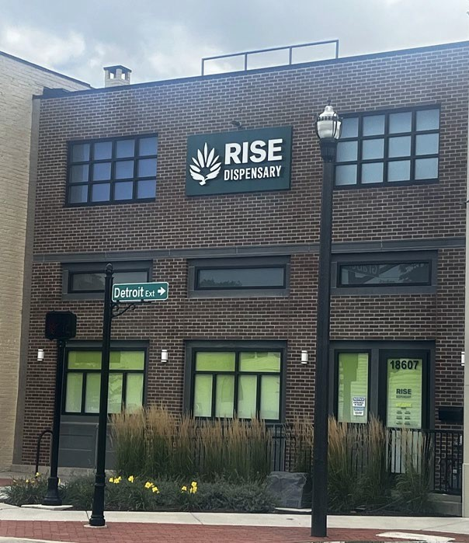
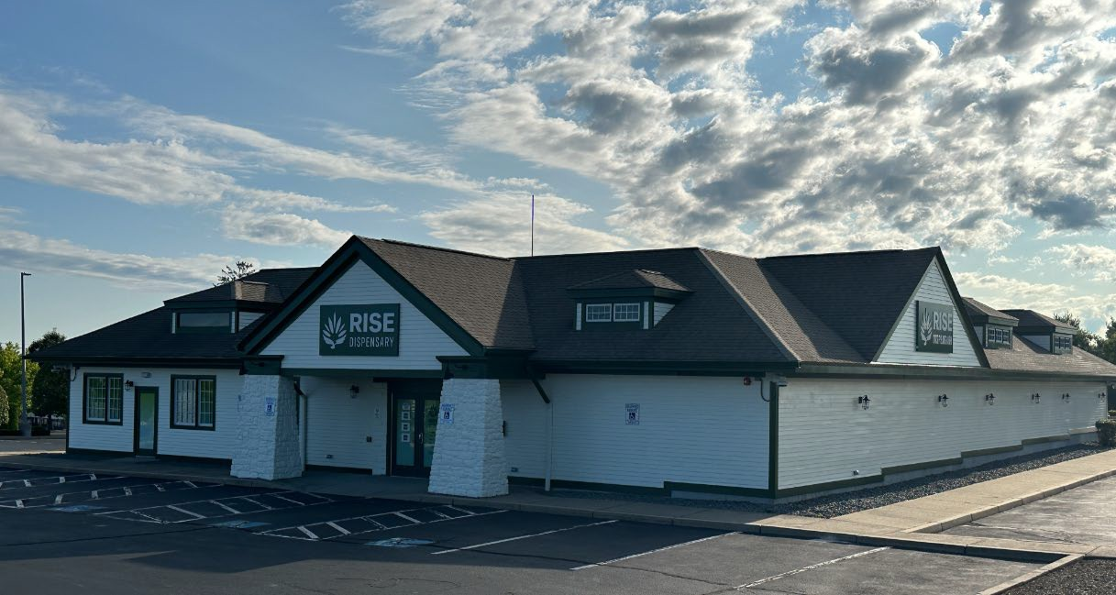
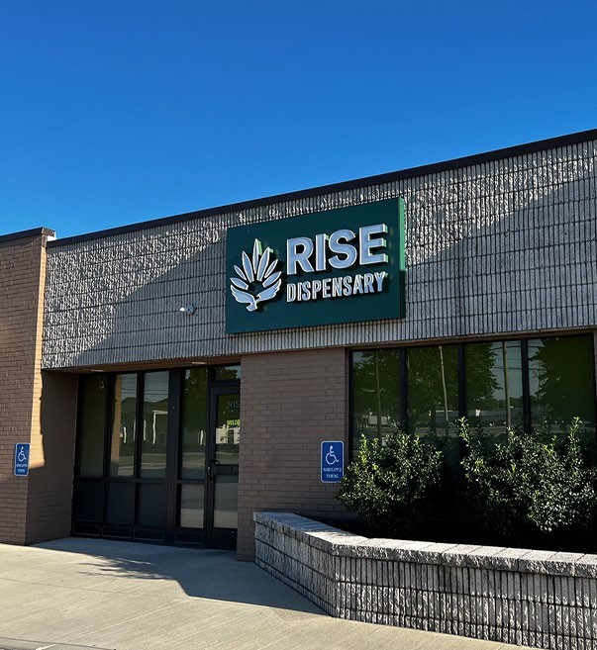
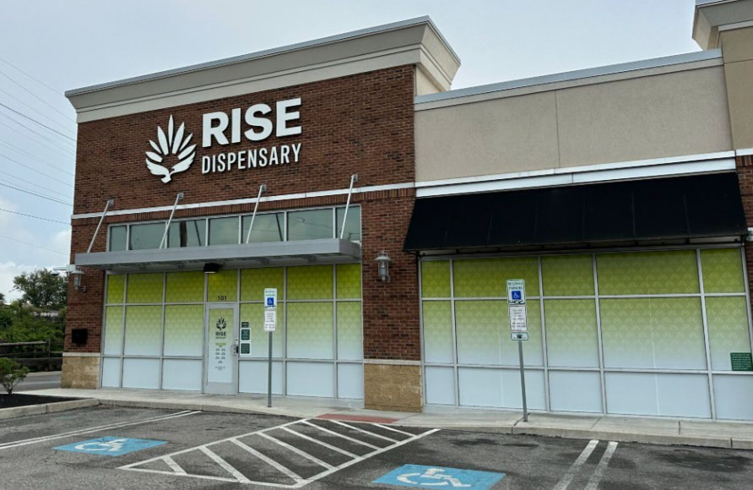
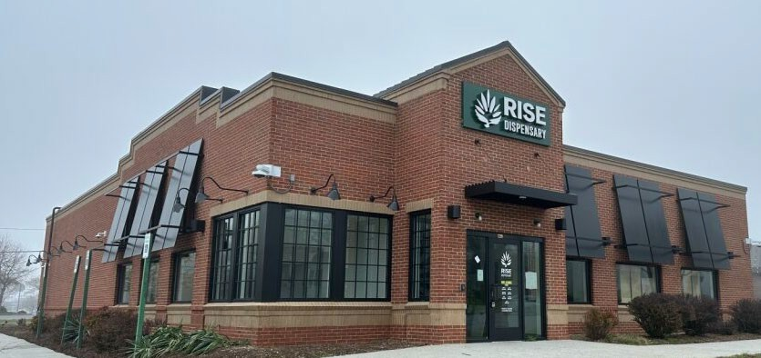
RISE – Best In Class Retail Experience
Confidential & Proprietary. For presentation purposes use only.

Slide 11
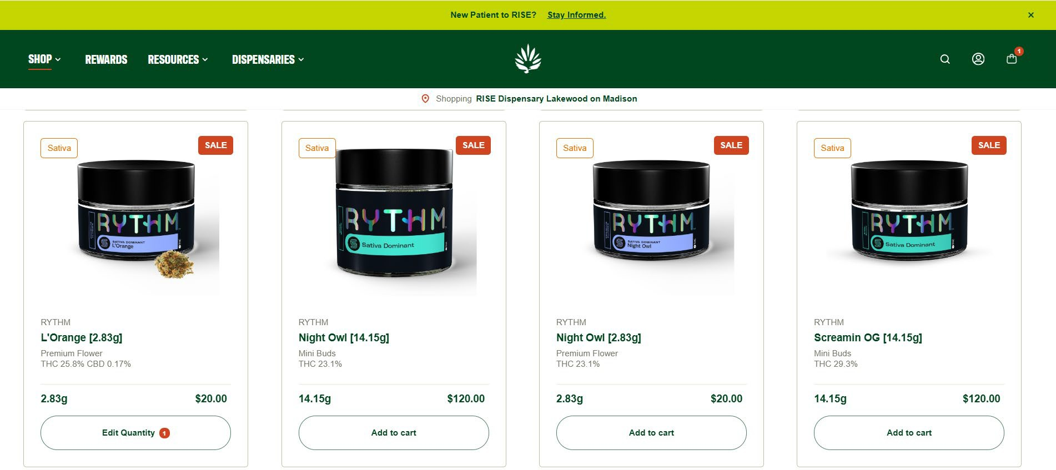
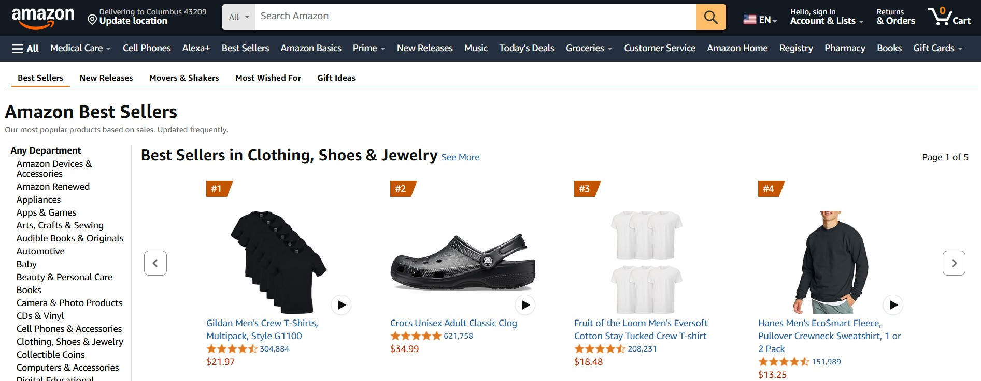
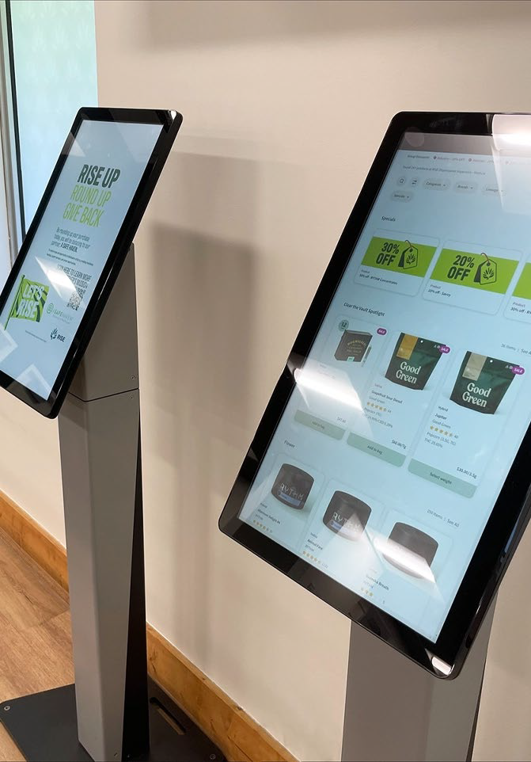
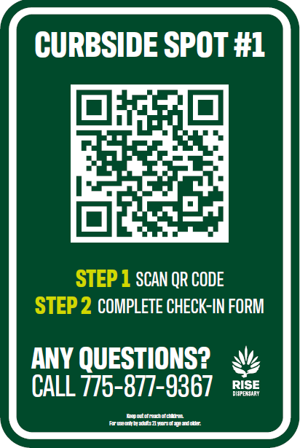
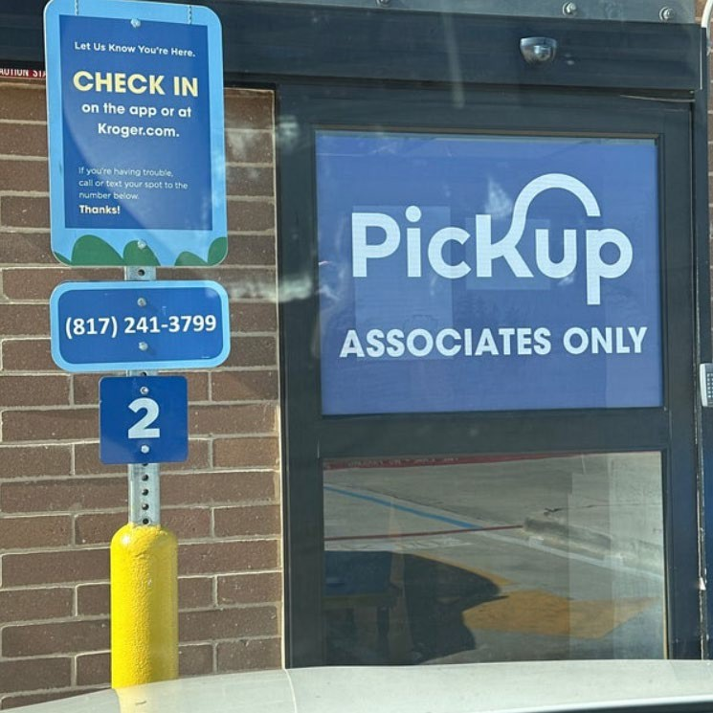
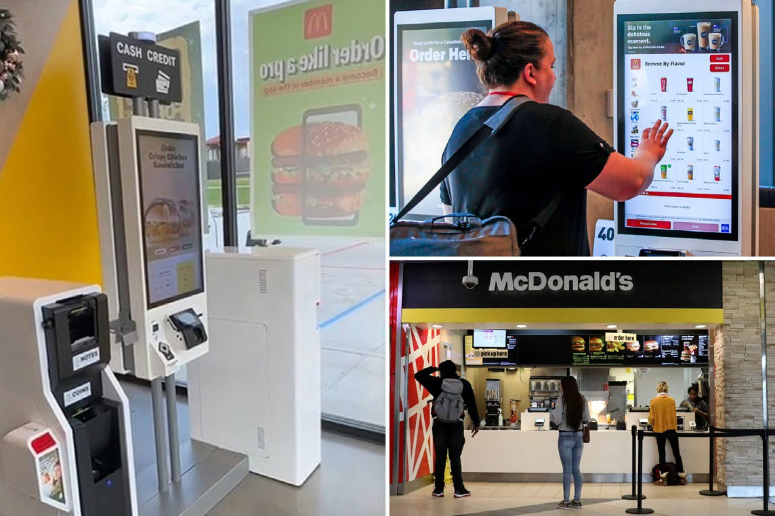
Similar Elevated Retail Experience Customers Are Accustomed To
*Familiar online shopping experience to browse menu offerings, build cart and schedule pickup (or delivery in available markets).
*Curbside pickup, like local grocery stores, is available.
*Shoppers have multiple means of purchasing in store including kiosk ordering.
Confidential & Proprietary. For presentation purposes use only.

Slide 12







Our Success Is Driven By Our Accomplished Retail Leadership
Our Retail Leadership Team brings over 120 years + of combined experience leading teams and operations in traditional retail settings. This wealth of retail knowledge combined with 10 years of regulated dispensary operations provides a valuable perspective for our business and our host communities.
Confidential & Proprietary. For presentation purposes use only.

Slide 13
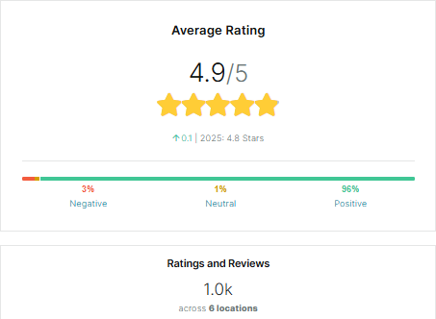
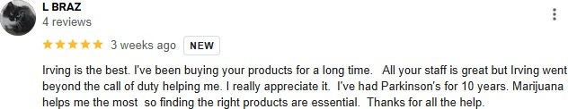
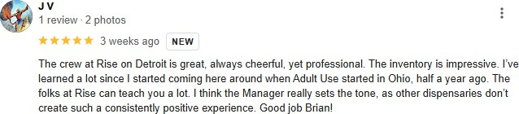
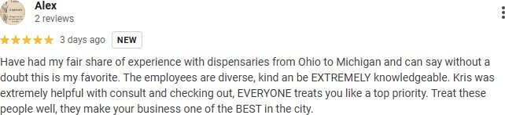
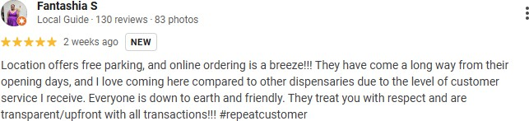
Public Sentiment of RISE in Ohio – Google Reviews
WHO ARE OUR CUSTOMERS?
Top 3 Age Groups |  |  | Gender Breakdown |  | Top 3 Segments
1 | 30-39 | 30% | Male | 43% | Male 30-39
2 | 40-49 | 25% | Female | 27% | Male 40-49
3 | 50-59 | 14% | Other | 30% | Female 30-39
Confidential & Proprietary. For presentation purposes use only.

Slide 14

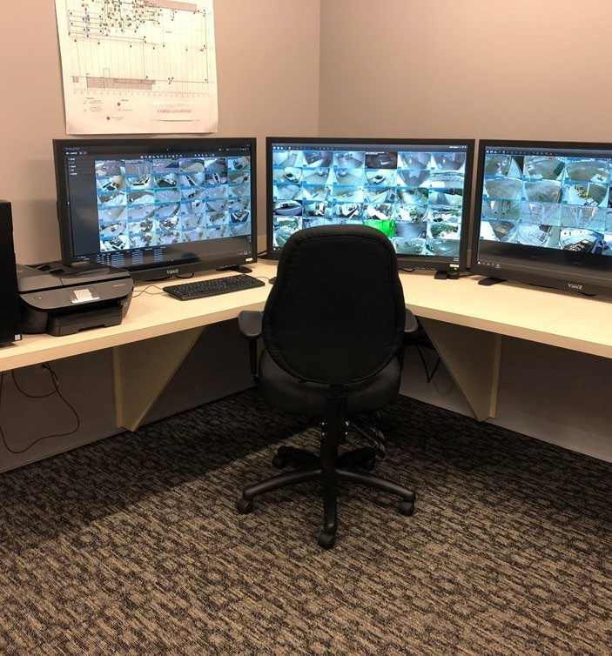
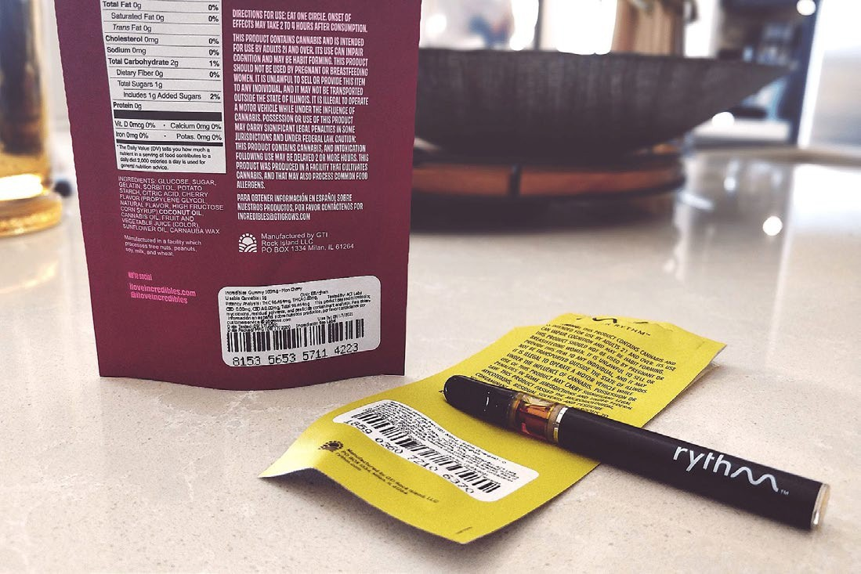

Proactive Safety + Security Protocols
21+ Age Verification
24/7 Camera Coverage
Camera coverage of entire facility
State Police and State Regulators granted full access to cameras
Internal monitoring via SOC
Restricted Access And Vault Storage
Products stored securely in vault
Back of house only accessible by authorized employees
Chain Of Custody Protocol
System tracks all products from delivery to sale
Third-party State-certified lab testing
Packaging coded with tracking information for full traceability
ID Scan Net Software
Prevents underage entrance and validates the ID presented
14

Slide 15
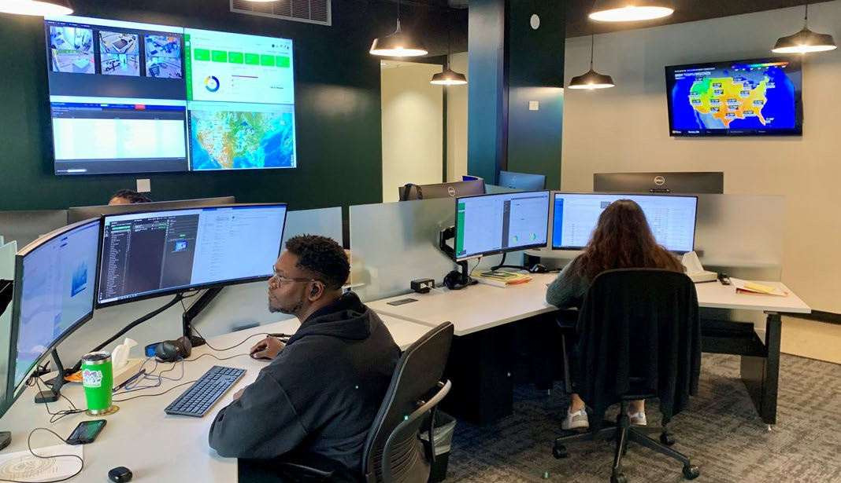
Role of the Security Operations Center (SOC)
Centralized hub of communications and business continuity for the enterprise 24/7/365.
Health &
Guidance and support before, during, and after an event.
SOC Specialists trained in response procedures and protocols.
Dispatch internal and external resources.
Full time facilities management team; site, grounds, building, all maintained with preventative maintenance & 24hr. service contracts.
SOC Alert notifications published for leadership and in support of event.
Facilitate corporate response to emergency and crisis situations.
Crime
Natural Disaster
Civil Unrest
Safety
SOC Operational Focus
Compliance
Operational Excellence
Product in Transit
Customer Analytics
Central business continuity support services via Helpdesk ticketing.
Remote security support for access control and alarm monitoring.
Compliance support and regulatory monitoring of CCTV and vehicles in transit.
Situational Awareness monitoring of business assets and provide expertise and response whenever business disrupting events occur.
155/11/2026

Slide 16
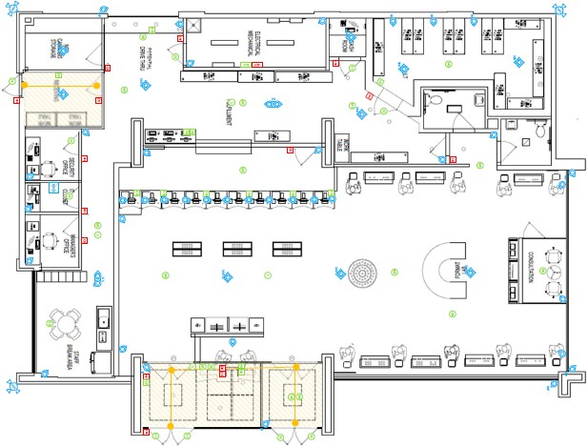
Physical Security
RISE Security Elements:
  Cameras providing coverage to every inch of the facility. No blind spots.
  Access control doors, including multi-factor ID and distinct levels of access.
  Motion detectors, glass breaks, panic and holdup alarms.
  Not pictured: Order fulfillment from the vault allows for additional control and safety for staff.
*Example of a RISE security overlay. This is not the proposed location.
Confidential & Proprietary. For presentation purposes use only.
16

Slide 17


Appendix
Confidential & Proprietary. For presentation purposes use only. 17

Slide 18
Issue 2 – By The Numbers
Issue 2 was the ballot initiative in November 2023 to commercialize, regulate, legalize, and tax the adult use of cannabis.
Voting Region | YES | NO
Brunswick Hills | 56.01% | 43.98%
Medina County | 53.83% | 46.17%
Confidential & Proprietary. For presentation purposes use only.

Slide 19
Known Concerns of Constituents – Public Safety
Studies show no increase in crime associated with adult-use cannabis dispensaries
  “The opening of state-licensed marijuana retailers does not negatively impact local crime rates, according to data.” (Dong and Tyndall (2023) The impact of recreational marijuana dispensaries on crime: Evidence from a lottery experiment)
  ”……an additional dispensary in a neighborhood leads to a reduction of 17 crimes per month per 10,000 residents, which corresponds to roughly a
19 percent decline relative to the average crime rate over the sample period. Reductions in crime are highly localized, with no evidence of spillover benefits to adjacent neighborhoods.” (Brinkman and Mok-Lamme (2019) Not in my backyard? not so fast. the effect of marijuana legalization on neighborhood crime)
Studies show no relationship between adult-use cannabis and an increase in traffic accidents/driving under influence of cannabis (DUIC)
  “The risk of DUIC in recreational (risk ratio [RR] = 0.41, 95% confidence interval (CI):0.23–0.72) and medical (RR = 0.39, 95% CI:0.20–0.79) states was lower than in states without legal cannabis, with one exception. Among frequent cannabis users (≥20 days per month), there was a significantly lower risk of DUIC for those living in recreational states (RR = 0.70, 95% CI: 0.49–0.99), but not for those living in medical states
(RR = 0.87, 95% CI: 0.60–1.24), compared to users living in states without legal cannabis.” (Dutra et al. (2022) Cannabis legalization and driving under the influence of cannabis in a national US sample revision 1)
  “There did not appear to be a relationship between the legalization of marijuana and the likelihood of finding THC in patients admitted after motor vehicle collisions.” (Kruse et al. (2021) Marijuana Legalization and rates of crashing under the influence of tetrahydrocannabinol and alcohol)
  “There is a lack of evidence that the traffic crash rate is statistically affected by the entry of recreational cannabis dispensary. Most of the estimates are small in magnitude and not statistically significantly different from zero.” (Gunadi (2022) Does expanding access to cannabis affect traffic crashes? county-level evidence from recreational marijuana dispensary sales in Colorado)
Confidential & Proprietary. For presentation purposes use only.

Slide 20
Known Concerns of Constituents – Impact on Youth
Studies show no impact/decrease in youth cannabis usage rates associated with adult-use cannabis sales/legalization
  “Using the Washington Health Youth Survey we show that after recreational cannabis legalization past 30-day cannabis use prevalence in grade 8 decreased by 22.0%, in grade 10 prevalence decreased by 12.7%, and no effect in grade 12. These trends are consistent with those in states without recreational cannabis laws, suggesting legalization did not impact adolescent use prevalence.” (Midgette and Reuter (2020) Has cannabis use among youth increased after changes in its legal status? A commentary on use of monitoring the future for analyses of changes in state cannabis laws)
  “The project’s study populations were specified to yield nationally representative estimates for all 51 major US jurisdictions, with probability sample totals of 819,543 non-institutionalized US civilian residents between 2008 and 2019…. The evidence indicates no policy-associated changes in the occurrence of newly incident cannabis onsets for underage persons” (Montgomery et al. (2022) Estimating the effects of legalizing recreational cannabis on newly incident cannabis use)
  “Based on the 2013 and 2015 Healthy Kids Colorado Survey data, permitting recreational cannabis dispensaries in a community does not appear to change student cannabis use or perceptions towards cannabis.” (Peters and Foust (2019) High School student cannabis use and perceptions towards cannabis in southcentral Colorado – comparing communities that permit recreational dispensaries and communities that do not)
  “Overall, past 30-day use was lower among youth who lived in ZIP codes with dispensaries (OR = .69, p < .05), with variation by grade. For example, only 10th (OR = .62, p < .05) and 12th graders (OR = .59, p < .05) living in a ZCWD had lower odds of past 30-day cannabis use. Additionally, only 12th graders in a ZCWD had lower odds of past-year use (OR = .70, p < .05). Finally, suburban youth living in a ZCWD also had lower odds of cannabis use (OR = .54, p < .01). Cannabis use was significantly lower among 10th and 12th graders living in a zip code with a dispensary.” (Smith et al. (2022) Adolescent cannabis use among youth in ZIP codes with medical dispensaries)
Confidential & Proprietary. For presentation purposes use only.

